Slide 1
Functional Computation and Formal Methods in ABM/S

Slide 2
Agenda
Motivation
Part I Introduction: ABM/S, Agents & OOP
Part II Functional Computation: Actor Model
Part III Formal Methods: Process Calculi
Conclusions

Slide 3
Motivation
Inspiring impulses
ABM/S taught by Prof. Hans Vollbrecht in S2
My masterthesis about ABM/S in computational economics
Interest in functional programming (Erlang & Haskell)
I wondered: OOP state-of-the-art in ABM/S but…
How to do ABM/S in a (purely) functional language?
Is it possible to do it conveniently?
Are there advantages doing it (purely) functional?

Slide 4
Part I Introduction: ABM/S, Agents & OOP

Slide 5
ABM/S Overview
Behaviour of system as a whole is unknown
Unknown key-values and dependencies
If known may be modelled as differential equation (but solvable?)
System comprised of individual small interacting objects
Knowledge about individual behaviour of objects and their interaction is available
Bottom up: identifying the objects and model their behaviour => Agents
Global behaviour of system emerges out of concurrent individual behaviours

Slide 6
What is an Agent?
Autonomous entity, following goals
Has it‘s own thread of execution
Living in an environment
Discrete / Continuous 2D / 3D space, graph topology,…
May interact with other agents by communication
Sending / receiving messages
Are always highly domain-specific
Focus on very specific agent-type in my PhD

Slide 7
Agents in Computational Economics: Zero-Intelligence (ZI) traders
Bid (buy) and ask (sell) randomly (within constraints) to increase utility
Utility: expected earnings from goods hold by agent, driven by traders limit-price
Limit-price: how much a trader values a product. To increase utility:
Sell above limit-price
Buy below limit-price
Do not learn / adapt, completely deterministic in behaviour
Tool to study properties and behaviour of market institutions and designs
In the process of a continuous double-auction (CDA)
Final agent‘s wealth distribution very close to theoretical Equilibrium
Notes:
Bid under constraints:
Rules depending on market design
Avoiding bankrupcy
ZI raise allocative efficiency to ~ 100%
allocative eciency Is a state in which all products match the consumers
preferences. In other words it means that goods are distributed optimally
between all consumers reecting the wants and tastes of the
agents involved. If allocative eciency is at 100% then it is not possible
any more to increase the utilities of both traders in a case of a trade
thus traders are no more willing to trade. In other words if two agents
trade at an allocative eciency of 100% then one agent will decrease
its utility and will lose. 16
Equilibrium: where angebot und nachfrage sind befriedigt

Slide 8
Example: ZI Agents trading Asset/Cash in CDA
Trading world with 2 possible states of „tomorrow“
Up: assets worth = 1.0
Down: assets worth = 0.2
Agents 1..N: Agent i is a quadruple Agent( i, h, c, a )
Optimism-factor h = i / ( N + 1 ), state „tomorrow“ is Up
Cash-Endowment c = 1.0
Asset-Endowment a = 1.0
All agents know each other: no restriction on trading between neighbours
Agents are zero-intelligent using limit-prices
limit-price = h + ( 1.0 – h ) * 0.2
Notes:
Optimism-factor: agents expectation asset worth 1.0 „tomorrow“

Slide 9
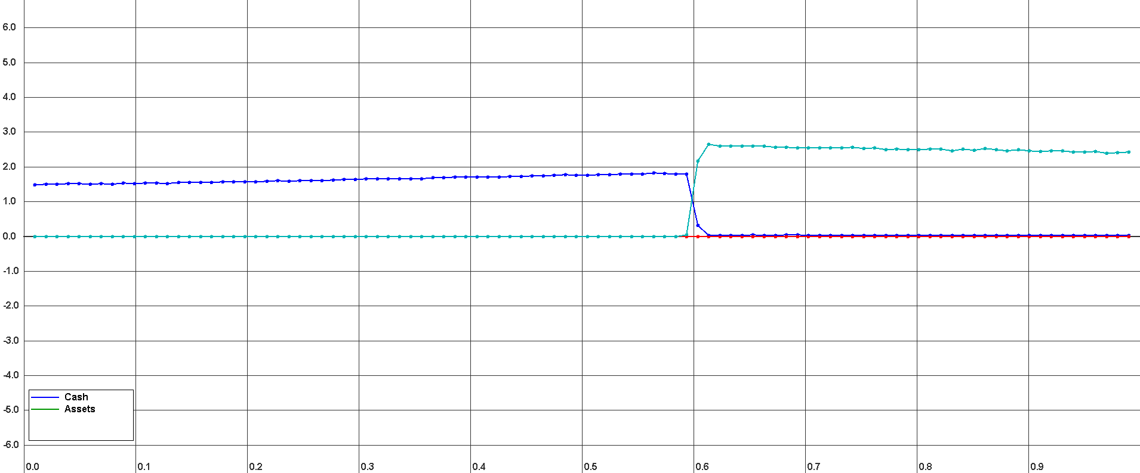
Equilibrium with 100 agents and 16 replications

Slide 10
Object-Oriented implementation in Java
Object-Orientation state-of-the-art in ABM/S
Agents implemented as Objects
State through private data belonging to Agent
Behaviour through methods belonging to Agent
Program composed of objects calling each others methods
Central coordinating CDA-Object
Objects are stateful and mutable (their state can change)
Important objects made globally accessible
Using inheritance to reuse code and specialization

Slide 11
Problems
Implementation is fake agent-based
Central coordinating / synchronizing Object / Process
Agent-Objects / Processes not autonomous
Implementations follow no formal specification
Neither the underlying system
Nor the problem solved with it
Questions „Is there a theory / formal system for specifying …
concurrent, distributed systems like an agent-based simulation?“
behaviour and semantics in such a system?“
Notes:
CDA-ZI model described in natural language in paper of Breuer, Vollbrecht et al.
Hard to understand all implications
Small details missing / only clear when implementing it

Slide 12
Part II Functional Computation: Actor Model

Slide 13
Introduction
Mathematical model of concurrent computation, invented by Carl Hewitt in 1973,
Actors central primitive, exchanging messages, identified by mail-addresses
React to received messages (no proactive actions possible)
Send finite number of message to other actors
Create finite number of new actors
Define the behaviour for the next message received
Time is no concept (not explicitly modeled) in Actor Model
Indeterministic message arrival order
Message delivery guaranteed after unbound time
Indeterministic message processing order
Concurrent message processing
Can send mail-addresses => variable topology
Notes:
Compare Actors with Agents, seem very similar => ideal approach to formal Agents
Proactive: no concept of time => no time-out driven emission of messages possible

Slide 14
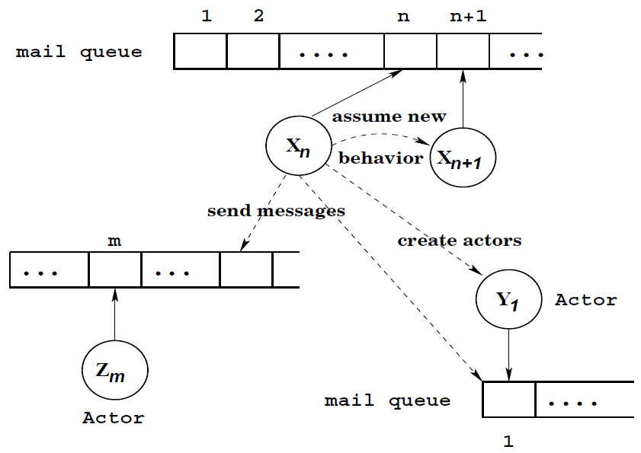
Actor System Illustration

Slide 15
Programming with Actor Model
Simple Actor Language (SAL) by Agha Gul
Abstract language with simple grammar
Primitives for all Actor Model concepts
Erlang inspired by Actor Model
Processes instead of Actors (PID instead of Mail-Addres)
Can‘t guarantee message delivery
No concept of behaviour for next message reception
No parallel processing of messages
Deterministic message processing in arrival order

Slide 16

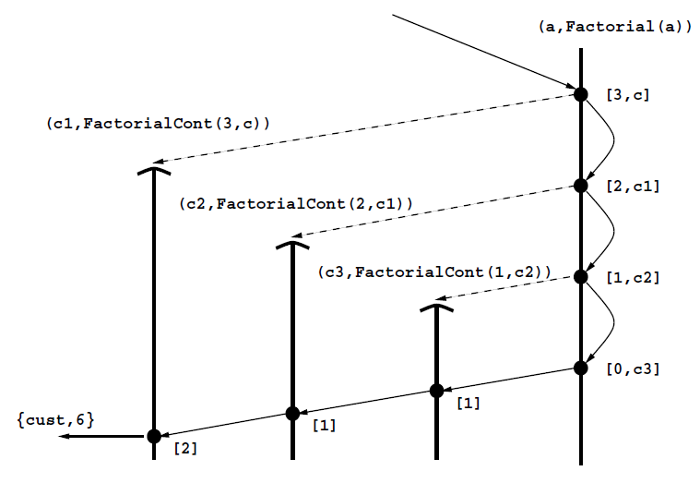
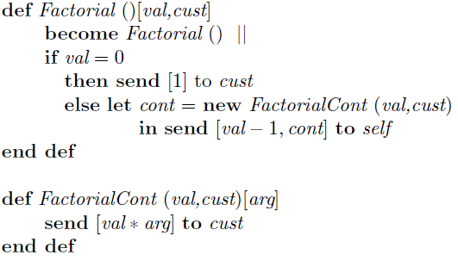
SAL Example: Factorial

Slide 17
Erlang implementation of SAL Factorial
calc( Val ) ->
FactPid = spawn( factorial, factLoop, [] ),
FactPid ! { Val, self() },
receive
Value ->
io:format( "~w! = ~w ~n", [Val, Value])
end.
factContLoop( Val, Cust ) ->
receive
Arg ->
Cust ! ( Val * Arg )
end.
factLoop() ->
receive
{ Val, Cust } ->
if
Val == 0 ->
Cust ! 1;
true ->
NewCust = spawn(factorial,factContLoop,[Val,Cust]),
self() ! { ( Val - 1 ), NewCust }
end,
factLoop()
end.
factorialMain <0.2.0> starts calculation of: 3!
factorial <0.31.0> started
factorial: recursion terminated, returning 1 to <0.34.0>
factCont <0.32.0> started: val 3, cust <0.2.0>
factCont <0.33.0> started: val 2, cust <0.32.0>
factCont <0.34.0> started: val 1, cust <0.33.0>
factCont: received arg 1 in <0.34.0>
factCont: received arg 1 in <0.33.0>
factCont: received arg 2 in <0.32.0>
Received result: 3! = 6

Slide 18
What we got
Theory for underlying concurrent & distributed system
Denotational & Operational Semantics available, see Part III
Implement proper agent-based solution in SAL / Erlang
No central CDA trading coordination
Agents trade directly: send messages directly to each other
Parallel and concurrent processing: no assumptions about arrival-ordering of messages possible
Indeterministic arrival-ordering and random timings closer to real CDA
But still no formal specification of the behaviour and semantics!

Slide 19
Part III Formal Methods: Process Calculi

Slide 20
Introduction
Origin in early 80s: Communicating Sequential Processes (CSP) by Hoare
Model of computation for concurrent systems
Formally modelling concurrent systems
Interaction of processes using message passing
Describing and combining processes using primitives
Algebraic laws for process operators: formal reasoning about processes
Bisimilarity / Bisimulation of 2 Systems
One can simulate the other, can‘t be distinguished by an observer
Useful: show that one model can bisimulate another (both are equivalent)
Notes:
Algebra: „The study of math. symbols and rules for manipulating them.“

Slide 21
Process Calculi ingredients
Names / Channels for communication
Forming new processes (from old)
Basic operators
Parallel composition of processes
Specifying which channels to use for sending / receiving
Sequentialization of interactions
Hiding of interaction points
Recursion or process replication
Reduction semantics performing computation
Seems to have much in common with Actor Model
Research-paper by Agha Gul combines pi-calculus with Actor Model
Notes:
https://en.wikipedia.org/wiki/Process_calculus

Slide 22
π – Calculus (Robin Millner, 1992)
Extension of the CCS (by Milner ~ 1980)
Channels can be sent as data
„Send“/Move Processes by sending its communication channels
Turing complete: can encode λ-calculus in π-calculus
Applications
Cryptographic Protocols
Specification of Biological Systems
Discrete Event Simulation (DES)
Model of a Spanish Fish Market
Notes:
ABM/S not really a proper treatment found, but papers found so far are good starting point

Slide 23
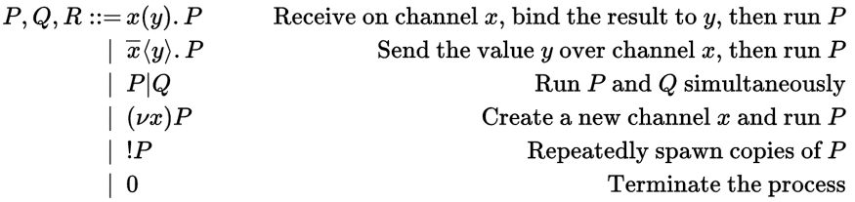
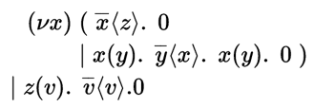
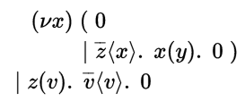

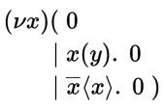
π – Calculus Syntax & Example with Reductions
Step 1
Step 3
Step 2
Notes:
https://en.wikipedia.org/wiki/%CE%A0-calculus#Formal_definition

Slide 24
Conclusions

Slide 25
Summary
How to do ABM/S in a purely functional language?
Functional Agent-System: Actor Model
Functional Model & Semantics: Pi-calculus
Is it possible to do it conveniently?
Are there advantages doing it purely functional?
Proofing of correctness (specification and implementation match)
Reasoning about system-properties: deadlock, termination, (bi)similarity
Application & Output: tool supporting computational economists
(Domain specific) Formal language for specifying CDA-ZI processes
Simulation framework in Haskell to run the formal language

Slide 26
Q & A

Slide 27
References
Big Book of Simulation Modelling – Andrei Borshchev
Multiagent Systems – Gerhard Weiss
An Introduction to Mulitagent Systems – Wooldrich
Communicating and mobile systems: the pi-calculus – Robin Milner
Actor Model – Agha Gul
A foundation for actor computation – Agha Gul, et al.
An algebraic Theory of Actors and its Application to a Simple Object-Based Language – Agha Gul, Prasanna Thatti
Using the pi-calculus to Model Multiagent Systems – Albert C and Toinette Rorie
Biological System pi calculus - Uhrmacher

Slide 29
CDA simulation algorithm
Shuffle agents
Request each agent to make 1 buy- & 1 sell-offering
Collect all bids and asks
Find first match randomly, if bid-price >= ask-price
Execute first match, discharge all remaining bids & asks
Repeat until termination
Random prices and random agent-sequence, therefore stochastic process
Replications needed
When to terminate?
Notes:
discharge all remaining bids & asks:
Could search for other matches which exclude previously matched agents

Slide 30
Roundup
Initial motivation
Too open and „want-to-do-it-all“ approach
Focus only on methods
No idea for interesting application
After reflection process (this presentation helped a lot!)
Clear idea where to go and what to do
Found very satisfying application
But can I really do it?
Highly complex problems!
3 years enough?

Slide 31
Main topics
Computational Economics: Continuous double auctions, zero-intelligence traders, market institutions, market design
Computation and formal languages: actor model, pi-calculus, denotational semantics, operational semantics, verification, correctness
Agent-Based Simulation: system simulation, emergent properties, dynamics of system, convergence, replications
Programming: pure functional, haskell, agda, type-systems, parallelism & concurrency in pure functional languages

Slide 32
Process Calculi

Slide 33
Introduction
Formal methods
Mathematical tools for specification, development & verification of software
Formal semantics
Mathematical theories for ascribing meanings to formal languages
Translates from domain of language‘s abstract syntax to:
another formally defined domain, depending on type of semantics
Uses
Provides unambigous definition of formal language
Programs can be verified formally against formal specification (correctness)
2 programs can be proved formally as (non-)equivalent
Reasoning about behaviour (deadlocks, termination ?)
Notes:
The following slides are just a small overview
Vast amount of research available
Don‘t know enough yet
Unclear what to use

Slide 34
Formal Semantics
Operational Semantics
Assumes some abstract machine for a formal language.
Meaning of program in terms of steps of computation.
Denotational Semantics
Mathematical model, no machine model / abstract machine.
Effect of statement as equation describing relation between input and output
Translation of program to formalized mathematical domain
Can describe all possible states of the original language
„The meaning of a program is the specification of the behaviour of the system into which that program is compiled.“

Slide 35
Actor Model Semantics

Slide 36
Introduction
Actor Model is event-oriented approach to semantics
decomposition into activation & arrival orderings
Lambda-Calculus semantics fail due to concurrency
The semantics of an actor model system is characterized by partially ordered sets of events
Single sequential actor: totally ordered set of events
System of actors: partially ordererd sets of events
Specification of an actor model system,is specifying the partial orderings between events
Notes:
(e.g. process receives a message A and reacts with a new message B, thus creating a partial ordering between A and B within the global system)

Slide 37
Operational & Denoational Semantics
Operational semantics by Irene Greif 1975
No global state/observations (may be unrealizable)
Develops theory of ordering constraints among events of parallel processes
Using Actor Event-Diagrams: operational details
Denotational semantics by William Clinger 1981
Uses global time (claims to be essential to any model of concurrent computation)
Denotations for concurrent system which are all possible behaviors the system can exhibit
Uses Actor Event Diagrams too: history of the evolution of a concurrent system
Very hard to understand
Can specify meaning of our (concurrent) Simulation System but still no formal specification language => Process Calculi
Notes:
Irene Greif (first woman PhD in Computer science from MIT)
Other semantic approaches exist too but out of scope

Slide 38
Pure functional implementation in Haskell
Agents represented as a record (named tuple of data)
State is public accessible (read-only)
No behaviour bound to agent (no methods / functions)
Program composed of global functions
Using recursion to iterate (no side-effects allowed)
Carrying the whole state around (no global data allowed)
Calling other functions to transform state (no side-effects allowed)
Note: This is not the way such a problem is implemented in Haskell. It served only as a first prototype to experiment with pure functional ABM/S implementation. The proper way would be to use Monads but this is beyond the scope of this presentation.
Notes:
Pure functional
Declarative instead of imperative: declare what function should compute instead of specifying each computation step executed after another
Bound names cannot be changed => on change create changed copy and return as result from computation

Slide 39
Process-Based implementation in Erlang
Agents represented as processes
State is private, encapsulated in process-recursion
Behaviour by receiving and sending messages
Program composed of N+1 processes
Central coordinating CDA process implementing CDA Algorithm
N agent-processes running
Communicating asynchronously by messages
This approach is much closer to the concept of autonomous agents than OO „Objects do it for free, agents because they want to.“

Slide 40
Code Example Erlang trading-agent makes sell-offers and sells trading-items
new( I, N ) ->
Id = I,
H = Id / ( N + 1 ),
Agent = { Id, H, 1.0, 1.0 },
Pid = spawn( agent, agentLoop, [ Agent ] ),
Pid.
sell( Pid, Price, Amount ) ->
Pid ! { sell, Price, Amount }.
makeAsks( Pid ) ->
Pid ! { makeAsks, self() },
receive
{ asks, AskData } ->
AskData
end.
agentLoop( Agent ) ->
{ Id, H, _, _ } = Agent,
receive
{ makeAsks, AuctionPid } ->
AskData = makeAsksInternal( Agent ),
AuctionPid ! { asks, AskData },
agentLoop( Agent );
{ sell, Price, Amount } ->
NewAgent = sellInternal( Agent, Price, Amount ),
agentLoop( NewAgent );
reset ->
NewAgent = { Id, H, 1.0, 1.0 },
agentLoop( NewAgent );
stop ->
io:format("stopping agent ~w...~n", [ Id ])
end.
sellInternal( Agent, Price, Amount ) ->
{ AskerId, AskerH, AskerCash, AskerAssets } = Agent,
{ AskerId, AskerH, AskerCash + Price, AskerAssets - Amount}.

Slide 41
π – Calculus computation
Tools available: deciding equivalence, finding deadlocks, interactive simulation
Translate specification to (pure) functional language
Implement π - Calculus constructs => EDSL
EDSL => looks nearly the same, very expressive
Existing π – Calculus implementations:
Nepi² Language: Lisp
π - Calculus analysis-tools: ML
My target: Haskell & Agda

Slide 42
Factorial SAL Example implemented in Haskell
Using existing Monadic implementation http://hackage.haskell.org/package/simple-actors-0.1.0/docs/Control-Concurrent-Actors.html

Slide 43
Translate SAL-Code to real programming language?
Danger of loosing expressiveness
Need functional language (Actor Model follows functional approach)
Good start: Erlang
Positive: close to Actor Model
Negative: expressiveness
Better: Haskell
Positive: denotational semantics => keeps expressiveness => direct translation = EDSL
Negative: must follow monadic approach => difficult, parallelism & concurrency very hard in pure functional environment

Slide 44
Implementing Asset/Cash CDA
How to implement it? Is there a „best way“ to implement it?
Multiple paradigms possible
Paradigms implemented by me
Object-Oriented in Java (my Masterthesis)
Pure functional in Haskell
Process / Agent-Based in Erlang
All above implemenations „straight-forward hacks“
No formal specification
No verification of correctness

Slide 45
Fake ABM/S implementations
Central coordinating / synchronizing object / process
Not proper agent-based because not autonomous
Idea for proper agent-based solution
No central CDA trading coordination
Agents trade directly: send messages directly to each other
Parallel and concurrent processing: no assumptions about arrival-ordering of messages possible
Indeterministic arrival-ordering and random timings closer to real CDA
Use a central coordinator for agent-creation, awaiting of termination and handling of multiple replications.

Slide 46
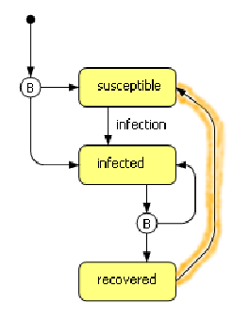
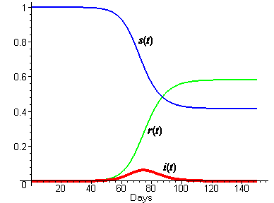
Modelling Agents: State-Automata
Agent comprised of multiple states
State-changes occur on events
Final states and state-changes over time of interest
Example: SIR (Susceptible-Infected-Recovered-Model) Model
Notes:
Maybe skip

Slide 47
Modelling Agents: Belief-Desire-Intentions (BDI)
Beliefs about environment the agent lives in
Sampling environment for up-to-date beliefs
Desire which goals the agent wants to achieve
Intentions about how to achieve the goals
Problem
Time to spend about reasoning what to do next
Time to spend sampling the environment
Used more in field of A.I. and reasoning

